Slide 1

Jaihind College of Engineering, Kuran.
A Project Presentation On
College Management Chatbot System
Presented by:
Khushi Mohammed Khan
Virendra Kashinath Shelavale
Sukaina Bano
BE Computer
Department of Computer Engineering

Slide 2
Contents
Introduction
Literature Survey
Motivation
Goal and Objectives
Problem Statement
Existing System
Proposed System
Methods/Algorithms
Hardware and Software
Architecture
Screenshots of Chatbot
Conclusion

Slide 3
Introduction
Chatbot is a Computer program that mimics the Human conversations in its natural form.
Chatbot for College management will be build using Artificial Intelligence Algorithm that will analyze user queries.
The system will reply to the user with the help of effective graphical user interface (GUI).

Slide 4
Literature Survey
Sr.No | Paper Title | Proposed Work | Advantage | Limitation
1 | A Conversation-Driven Approach for Chatbot Management | In this paper , Artificial Intelligence is used to develop an chatbot. | This paper proposes an approach to content management for textual chatbots supervised by humans. | Chatbot are designed with an specific domain.
4

Slide 5
Motivation
Chatbots are very useful and fast to communicate with humans.
The main Motivation Behind this project is that we want to reduce the work load on college faculty and to save the time of everyone by developing an online chatbot for college.

Slide 6
Goal and Objective:
To create online chatbot for college work or queries related to college.
To reduce the work load on college Faculty.
To reduce the Crowd at Account Section.

Slide 7
Problem Statement:
Building an Chatbot for College Management Using Artificial Intelligence.

Slide 8
Existing System
The term Conversation-Driven Development (CDD) is in the context of the chatbots.
Rasa X is actually a tool developed to support CDD, which makes conversations the main source of information to trigger changes in the chatbot content.
CDD is centered on machine learning and the trained model performance.
We will make Changes in the Existing System to Develop an More advanced chatbot platform for our College.

Slide 9
Proposed System:
User Login and can ask the question.
Chatbot Responding System:
NLP Processing and Sentiment Analysis for Complaint.
Search Question in Knowledge Database.
Answer the question or Queries.

Slide 10
Method/Algorithms
Porter Stemmer Algorithm.
Word Order Similarity between Sentences.
NLP Techniques

Slide 11
Hardware and Software
Hardware Requirement:
System - Pentium-IV.
Hard disk - 320GB
RAM – 4 GB
Software Requirement:
Operating System - Windows 10
MongoDB
Node js
Visual Studio Code

Slide 12
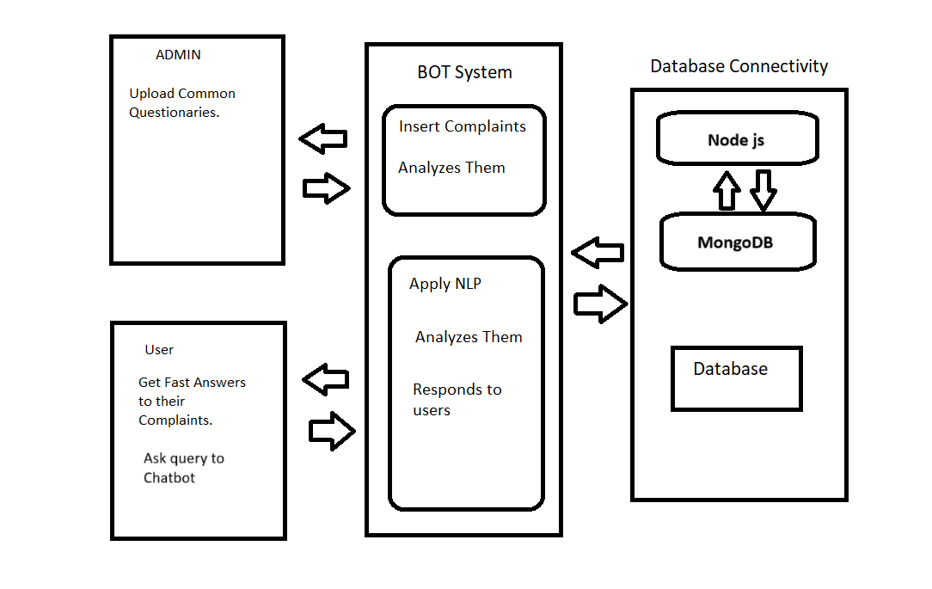
Architecture

Slide 13
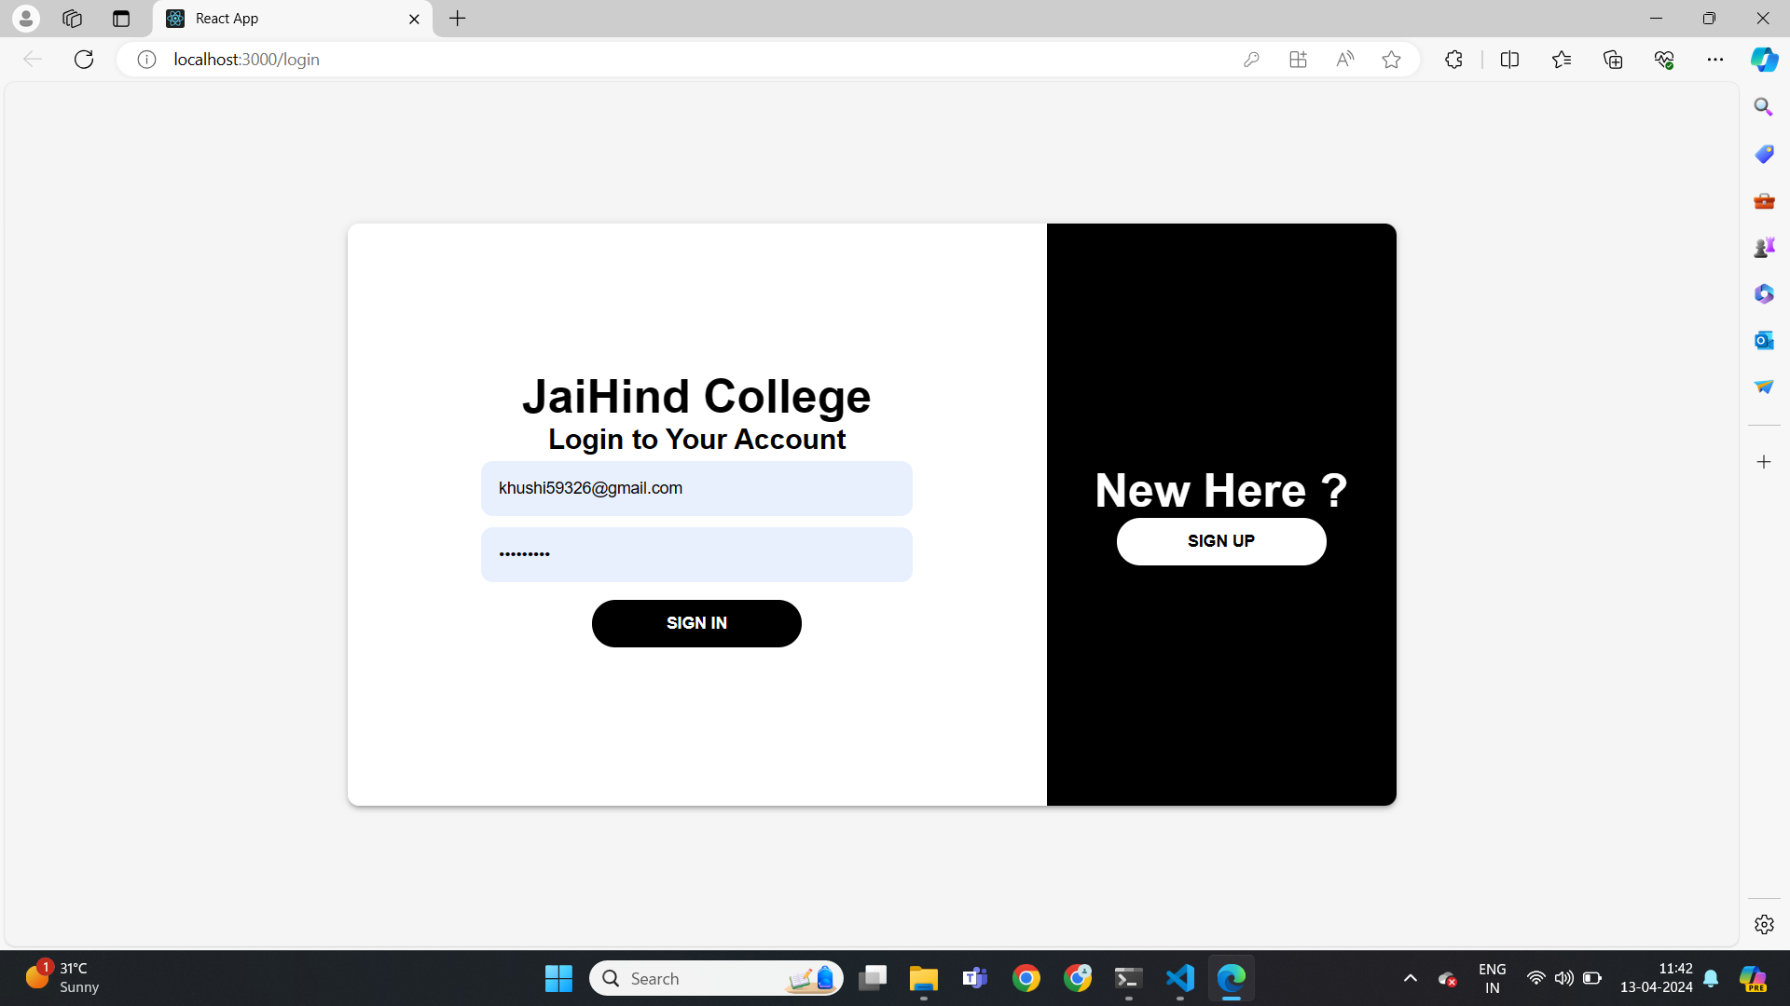
Screenshots of Chatbot

Slide 14
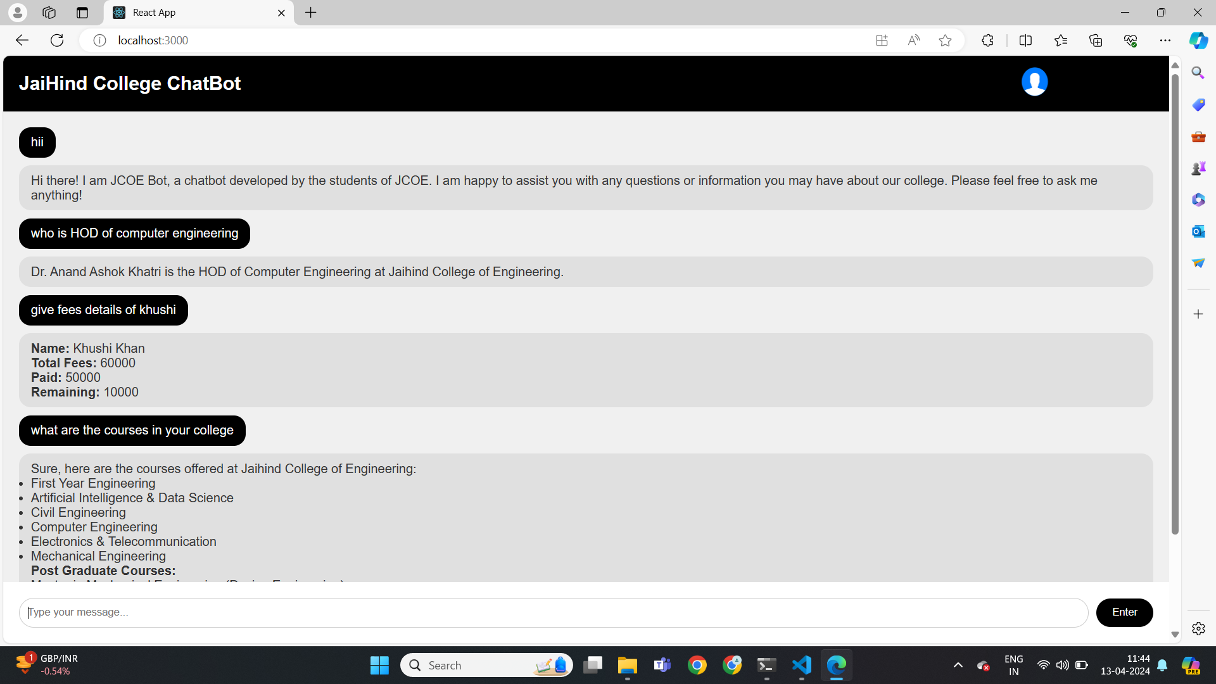
Screenshots of Chatbot

Slide 15
Conclusion:
We created a Chabot that any organization can use to help for users to ask their questions. Once the query is registered automatic tokens are generated and provided in the database to the customer via text message. Natural language processing technologies are used to analyze, tokenize, stem and filter the content of the Inquiry. The output is fed to algorithm where sentence strength is calculated. The intensity of the negation is calculated, which helps to prioritize a query that the service provider automatically resolves Query. In this way, the proposed system will help many organizations ensure customer satisfaction with less human effort. The College Management System saves a lot of time for both College students and faculty.

Slide 16
Thank You..!!

